Slide 1
LGBTQ Substance Abuse Issues

Slide 2
Adrien Lawyer
Transgender Resource Center of New Mexico
Executive Director
Co-Founder
www.tgrcnm.org
505-440-3402
adrien@tgrcnm.org

Slide 3
LGBTQ(QIAA2-S)?
Lesbian
Gay
Bisexual
Transgender
Queer
Questioning
Intersex
Ally
Asexual
Two Spirit

Slide 4
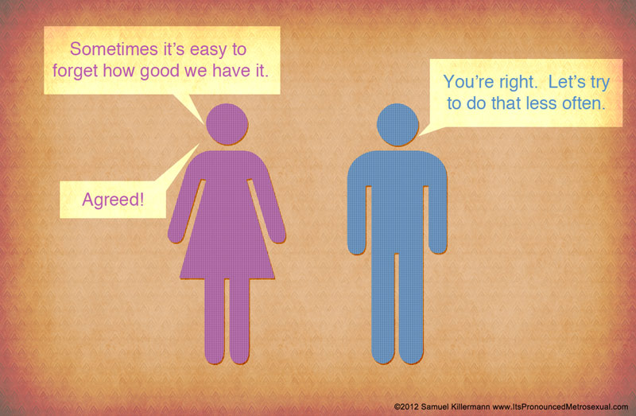
Cisgender?
Opposite of transgender

Slide 5
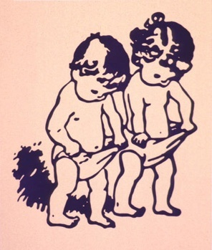
Let’s talk about T
Assigned Sex at Birth
Gender Identity
Gender Expression
Sexual Orientation

Slide 6
Where Do I Fit?
Gender
Each of us has one (or more):
Sex assigned at birth
Gender identity
Gender expression
Sexual orientation
Both
Gender Expression
Gender Identity
Sex assigned at birth
Male
Sexual Orientation
Female
Both
Partner’s Gender Identity
Partner’s SAB
Male
Female
Neither
Neither

Slide 7
Transgender Substance Abuse
The National Institutes of Health (NIH) estimate that 7.3% of the general public abuses or is dependent on alcohol, while 1.7% abuses or is dependent on non-prescription drugs.
Eight percent (8%) of respondents to Injustice At Every Turn reported currently using alcohol or drugs specifically to cope with the mistreatment that they received as a result of being transgender or gender non-conforming, while 18% said they had done so in the past but do not currently.

Slide 8
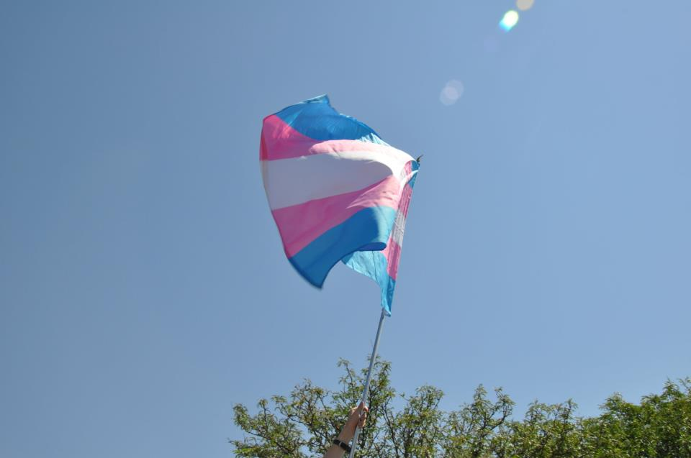
Additional Risks
Doing sex work, drug sales, and other work in the underground economy for income more than doubles the risk of alcohol or drug use because of mistreatment, with 19% of these respondents currently using alcohol and/or drugs while 36% reported that they had done so in the past.
Physical attack due to bias = 15%
Sexually assaulted due to bias = 16%
Lost a job due to discrimination = 12% reported current use, while 28% have done so in the past.

Slide 9
LGBT Substance Abuse
Although data on the rates of substance abuse in gay and transgender populations are sparse, it is estimated that between 20 percent to 30 percent of gay and transgender people abuse substances, compared to about 9 percent of the general population.

Slide 10
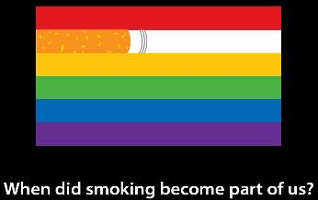
Tobacco
Gay and transgender people smoke tobacco up to 200 percent more than their heterosexual and cisgender peers.

Slide 11
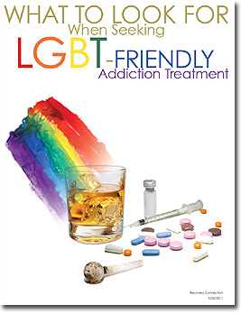
Alcohol
Twenty-five percent of gay and transgender people abuse alcohol, compared to 5 to 10 percent of the general population.

Slide 12
Other Drugs
• Men who have sex with men are 3.5 times more likely to use marijuana than men who do not have sex with men.
• These men also are 12.2 times more likely to use amphetamines than men who do not have sex with men.
• They are also 9.5 times more likely to use heroin than men who do not have sex with men.

Slide 13
Primary Co-factors
“Minority Stress”
Stigma, discrimination and violence in many areas of life including: employment, education, relationship recognition, health care

Slide 14
Primary Co-factors
Lack of cultural competency in the health care system
Primary care, behavioral health and substance abuse providers often lack basic knowledge.
LGBTQ people do not seek help.
When they do, results can range from irrelevant services to abusive experiences.

Slide 15
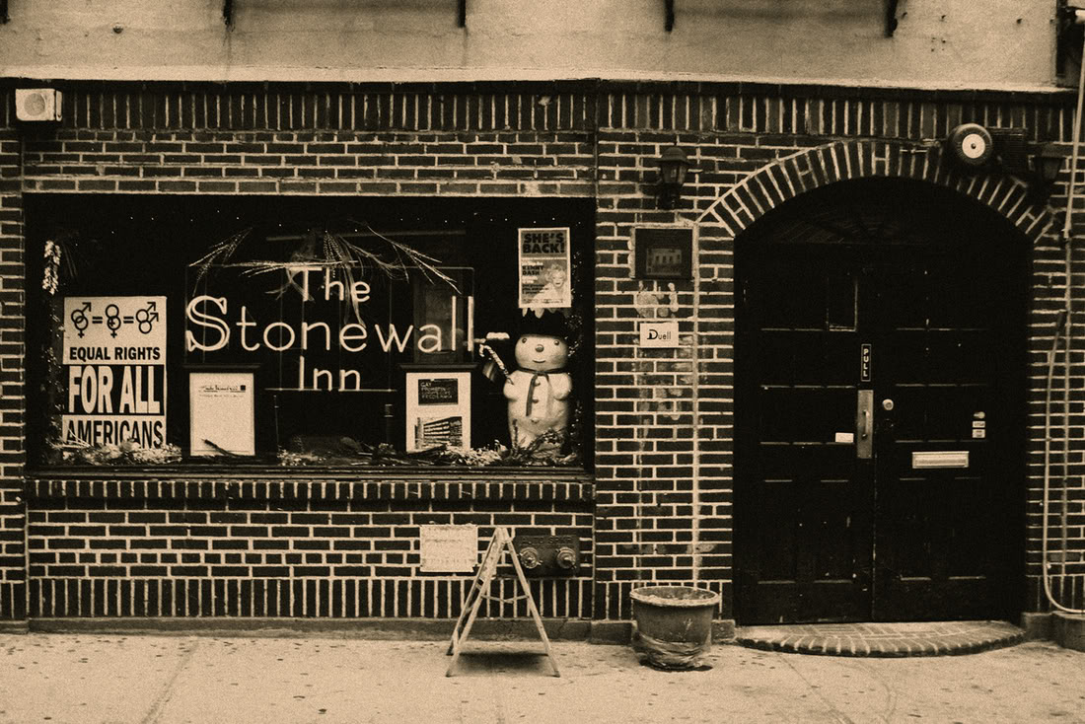
Primary Co-factors
Targeted Marketing
Alcohol and tobacco companies target LGBTQ people for marketing efforts.
In many places, bars are still the only community centers.

Slide 16
How Do You Help?
Best Practices Institute
Additional, ongoing training for all staff
Non-discrimination policy – including sexual orientation AND gender identity and gender expression
Update intake and other processes

Slide 17
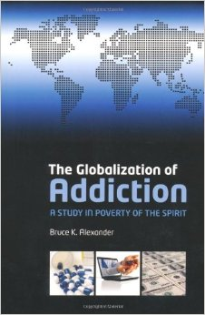
Turning the Corner in Understanding
Gabor Maté
In the Realm of Hungry Ghosts
Bruce K. Alexander
The Globalization of Addiction

Slide 18
Local Resources
Transgender Resource Center of New Mexico
UNM LGBTQ Resource Center
New Mexico Department of Health Harm Reduction - http://nmhealth.org

Slide 19
Source Materials
Center for American Progress - Why the Gay and Transgender Population Experiences Higher Rates of Substance Use - http://www.americanprogress.org/wp-content/uploads/issues/2012/03/pdf/lgbt_substance_abuse.pdf
Injustice At Every Turn – National Center for Transgender Equality & National Gay and Lesbian Task Force - http://www.thetaskforce.org/reports_and_research/ntds

