Slide 1
Addiction in Young Adults
Treating the Whole Family

Slide 2
DSM Definition of Dependence
A maladaptive pattern of alcohol use, leading to clinically significant impairment or distress, as manifested by three or more of the following seven criteria, occurring at any time in the same 12-month period:
Tolerance, as defined by either of the following:
A need for markedly increased amounts of alcohol to achieve intoxication or desired effect.
Markedly diminished effect with continued use of the same amount of alcohol.
Withdrawal, as defined by either of the following:
The characteristic withdrawal syndrome for alcohol (refer to DSM-IV for further details).
Alcohol is taken to relieve or avoid withdrawal symptoms.
Alcohol is often taken in larger amounts or over a longer period than was intended.
There is a persistent desire or there are unsuccessful efforts to cut down or control alcohol use.
A great deal of time is spent in activities necessary to obtain alcohol, use alcohol or recover from its effects.
Important social, occupational, or recreational activities are given up or reduced because of alcohol use.
Alcohol use is continued despite knowledge of having a persistent or recurrent physical or psychological problem that is likely to have been caused or exacerbated by the alcohol

Slide 3
Addiction as an Attachment Disorder
• THE DEGREE TO WHICH A PERSON CAN REGULATE THEIR OWN EMOTIONS IS REGULATE THEIR OWN EMOTIONS IS DETERMINED BY THE LENGTH & STRENGTH OF THEIR EARLIEST ATTACHMENT EXPERIENCES.
THE BIOLOGICAL LIMITATIONS OF SELF REGULATION
THE MANDATE FOR ATTACHMENT: INTERPERSONAL RELATIONSHIPS (SECURE ATTACHMENTS) ARE ESSENTIAL FOR OPTIMAL BRAIN FUNCTIONING.
THE SAME AREA OF THE BRAIN THAT MEDIATES SEX, THIRST, HUNGER,FIGHT-FLIGHT (SURVIVAL) ALSO MEDIATES ATTACHMENT.
THE CNS OF ALL SOCIAL MAMMALS IS AN OPEN FEEDBACK LOOP
THE ESTABLISHMENT OF ATTACHMENT AND SECURE BASE IN THERAPY PREDICTS SUCCESSFUL TREATMENT OUTCOME.
ADDICTION AS A RELATIONAL DISORDER:
RELATIONSHIP WITH SELF
RELATIONSHIP WITH OTHERS
RELATIONSHIP WITH SOCIETY (EXISTENTIAL REALTIONSHIP)

Slide 4
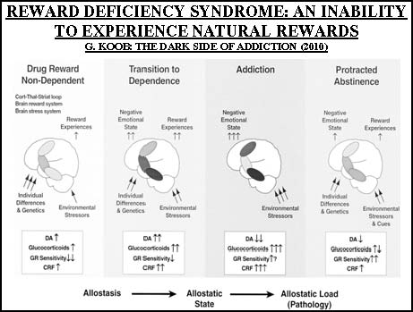

Slide 5
Compounding Factors in Attachment
Importance of Family HX (adult attachment questionnaire Mary Main)
Family environment, relational, economic, social, psychological and health/medical stressors as barriers to secure attachment.

Slide 6
Defense Mechanisms
Defense mechanisms are a type of process or coping that results in automatic psychological responses exhibited as a means of protecting the individual against anxiety (Dziegielewski 2010). Identification and notation of defense mechanisms can be an important part of the psychological assessment and influence on the treatment process

Slide 7
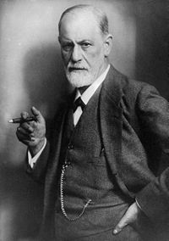
Defense Mechanisms
Freud
Unconscious mental processes employed by the ego to reduce anxiety
Notes:
Keywords: defense mechanisms

Slide 8
Defense Mechanisms
Freud's Defense Mechanisms include:
Denial: claiming/believing that what is true to be actually false.
Displacement: redirecting emotions to a substitute target.
Intellectualization: taking an objective viewpoint.
Projection: attributing uncomfortable feelings to others.
Rationalization: creating false but credible justifications.
Reaction Formation: overacting in the opposite way to the fear.
Regression: going back to acting as a child.
Repression: pushing uncomfortable thoughts into the subconscious.
Sublimation: redirecting 'wrong' urges into socially acceptable actions.

Slide 9
Defensive Functioning Scale
Defense mechanisms (or coping styles) taken from Appendix B in DSM IV – TR are automatic psychological processes that protect the individual against anxiety and from the awareness of internal or external dangers or stressors. Individuals are often unaware of these processes as they operate.

Slide 10
Defense Levels
High Adaptive Level: Defense mechanisms in this group result in optimal adaptation to stress.
The defenses usually maximize feelings of well being and
Allow the conscious awareness of feelings, ideas, and their consequences.
promote an optimum balance among conflicting motives

Slide 11
High Adaptive Level
anticipation
affiliation
altruism
humor
self-assertion
self-observation
sublimation
suppression

Slide 12
Defense Levels
Mental Inhibition Level: Defense mechanisms in this group keep potentially threatening ideas, feelings, memories, wishes, or fears out of awareness. Diminished awareness can affect the person's ability to relate to others.
displacement
dissociation
intellectualization
isolation of affect
reaction formation
repression
undoing

Slide 13
Defense Levels
Minor image-distorting level. This level is characterized by distortions in the image of the self, body, or others that may be employed to regulate self-esteem. Examples are
devaluation
idealization
omnipotence

Slide 14
Defense Levels
Disavowal level. This level is characterized by keeping unpleasant or unacceptable stressors, impulses, ideas, affects, or responsibility out of awareness with or without a misattribution of these to external causes. Examples are
denial
projection
rationalization

Slide 15
Defense Levels
Major image-distorting level. This level is characterized by gross distortion or misattribution of the image of self or others. Examples are
autistic fantasy
projective identification
splitting of self-image or image of others

Slide 16
Defense Levels
Action Level: This level is characterized by defenses that deal with internal or external stressors by action or withdrawal.
acting out
apathetic withdrawal
help-rejecting complaining
passive aggression

Slide 17
Defense Levels
Level of defensive dysregulation. This level is characterized by failure of defensive regulation to contain the individual's reaction to stressors,
lead ins to a pronounced break with objective reality. Examples are
delusional projection
psychotic denial
psychotic distortion

Slide 18
Use Abuse and Dependence
Family Values regarding use
Social consequences and the beginning of Denial in the Family
First Crisis that leads to an intervention
Secondary Denial and Magical Thinking about Treatment

Slide 19
Treatment as Containment
Behavioral, emotional and psychological containment
Family as Client: identified patient as well as family members struggling with anger, resentment, shame, guilt.
EDUCATION!
Family systems approach; de-emphasize identified patient role, Genogram, Al-Anon and Family Therapy/support, peer coaching.

Slide 20
Family Dynamics
Each time we focus on the addict without focusing on the family, we are in denial that we are breaking the cycle of addiction.
Parental Role: Basic needs of safety, food, shelter
• Appropriate role modeling, warm and supportive relationship between the parent and child, parental monitoring and supervision, maintaining awareness of the child’s peer relationships, understanding the child’s individual risk level and establishing appropriate parent child communication

Slide 21
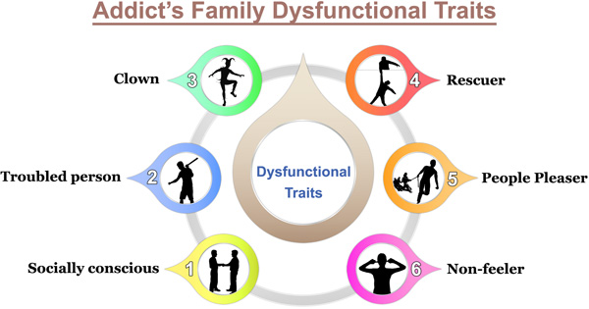

Slide 22
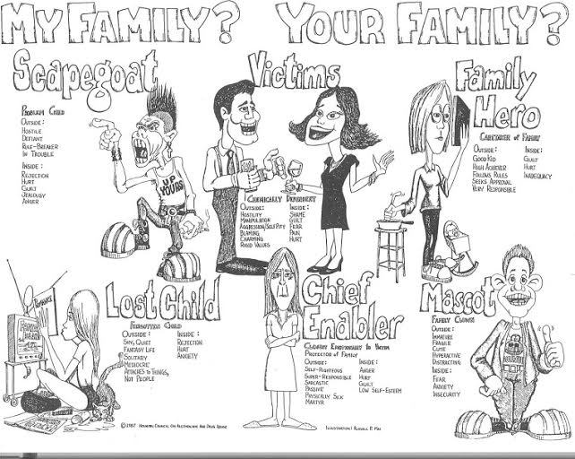

Slide 23
Dysfunction
Abandonment: When you have to hide a part of who you are in order to be acceptable/ to protect self.
Emotional Abandonment
When you have to hide:
—Your mistakes/ vulnerabilities
— Your feelings
— Your needs
— Your accomplishments/ success

Slide 24
Shame
Shame Coping
Power Over Pain: Control, Rage, Perfectionism
Succumb To Pain: Procrastination, Victim, Depression/Anxiety, Suicide
Coping with The Pain: Addiction

Slide 25
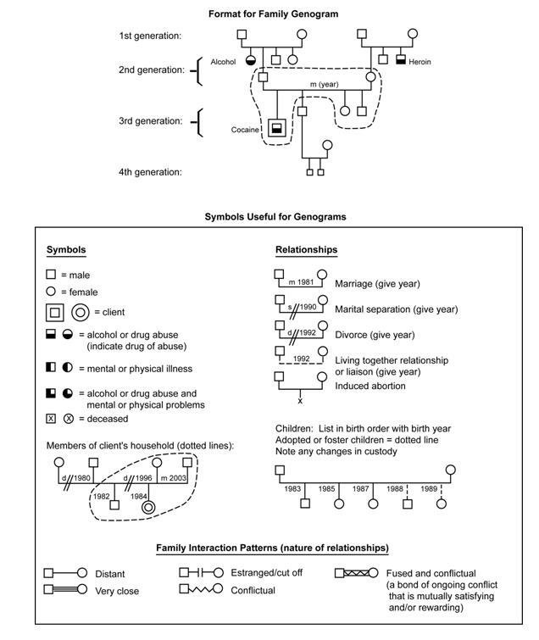

Slide 26
Co-Dependency
•Family members aren’t sure what they feel, so have difficulty sharing their emotions
•Family interactions or decisions are often focused around the addict or alcoholic
•Open communication is difficult, since a pattern of avoidance or denial has been set in place
•Blame and anger are often present, making it difficult for common solutions to be found
•Codependent family roles keep the addict from hitting rock bottom
•Family members do whatever it takes to avoid confrontation, chaos or pain

Slide 27
Enabling
The Enabler is a helpful type, trying to rescue their child from their predicament. The Enabler wants to save the addict from the immediate crisis and relieve them of the unbearable tension created by the situation.
In reality, this person is meeting a need of their own, rather than that of the addict, although the Enabler does not realize this themselves.
The Enabler denies the addict the process of learning by correcting and taking responsibility for his/her own mistakes.
Preventing “Legitimate Suffering” is the biggest form of Parental Abuse…

Slide 28
Communication
Conflict: Aggressive, Passive and Passive Aggression and Assertiveness: enmeshment, triangulation, parentification.
Boundaries and Letting GO
Patient’s ability to assert communication with family and find own voice is essential for individuation

Slide 29
Re-Integration ONE’S ABILITY TO ESTABLISH HEALTHY REGULATORY RELATIONSHIPS OUTSIDE OF THE THERAPEUTIC MILIEU IS SYNONYMOUS WITH MENTAL HEALTH AND IS INDICATIVE THAT PSYCHOTHERAPY TREATMENT HAS BEEN SUCCESSFULL
DETOX FOR PHYSICAL STABILIZATION
PSYCH EVALUATION/MEDICATION MANAGEMENT FOR NEUROTRANSMITTER STABILIZATION AND AFFECT REGULATION
NEURO-FEEDBACK FOR NEUROLOGICAL STABILIZATIONN
CBT and EMDR for TRAUMA
IMPROVED COMMUNICATION AND SOCIAL SKILLS
AUTONOMY TOWARDS FINANCIAL INDEPENDENCE (ABILITY TO BUDGET), SOCIAL AND PEER SUPPORT (12 STEP MEETINGS, SPONSOR)
DECREASING LEVELS OF ENMESHMENTS WITH FAMILY OF ORIGIN
EMPLOYMENT, EDUCATION, FINANCIAL RESPONSIBILITY

Slide 30
Aftercare and Recovery
Rule In or Out of Definitive Co-occurring DX
DSM definition of Remission (coincides with AA/12 Step Culture), Brain Function and full stabilization and ability to self regulate, social functioning, re-integration, personal and relational.
Ongoing family and Individual work

