Slide 1
Mindfulness and Urges
I’m always hungry for more, more, more…..
The Hungry Ghost

Slide 2
The purpose of this presentation is to bridge the gap between Urges for more and the desire for less and mindfulness practice.

Slide 3
Agenda
Define mindfulness
Developing mindfulness practices
  Coherent breathing
  Moving mind
  Breathing with sensation, sounds
    Myopic aspect of addiction
  Body scan
  Thought tagging
Mindfulness research will be interspersed throughout presentation
Working mindfully with addictions
  Wanted urges
  Unwanted sensations
  Intimacy
Self-care

Slide 4
What is Mindfulness?
Instead of daydreaming or thinking about it, pay attention to the objects of perception.
  Sights
  Sounds
  Sensations
  Odors
  Tastes
  Thoughts
  Feelings

Slide 5
Mindfulness in the context of our lives
Reacting to the reactions
Reactions based on interpretations
Interpretation of events, sensations, etc.
Direct experience of objects of perception

Slide 6
We’re happier when our mind isn’t wandering!
Killingsworth & Gilbert, 2010
Unpleasant mind wandering
Neutral mind wandering
Pleasant mind wandering
Not mind wandering
Unhappy Happy

Slide 7
Awareness of the hands: Kurt
Pay attention to your hands without looking at them.
When your mind wanders bring it back to your hands
Let your awareness fill your hands inside to out
Open your awareness to all sensation including the air in and around your fingers
Move your hands to the chair. Pay attention to the physical sensations
Feel the muscles tightening and relaxing
Ease off keep awareness on change of sensations

Slide 8
Mindfulness Exercise: Kurt
Coherent breathing
  Focus on sensation of the breath in the belly
    Diaphragmatic breathing
  Count in breath
  Count exhalation
    Relax on each exhalation
  When your mind wanders into thinking, note it and let it go. Return your attention to your breath…

Slide 9
Motivation
  “At a biochemical level all addiction is to create an altered state in the brain…addiction is never purely psychological.” Gabor Mate, p. 137

Slide 10
Simple Motivation: Mark
Classical conditioning
  A cigarette get’s paired with good feeling, something to do, cig’s a friend, not alone.
Positive Reinforcement
  We do ___to get the good feeling. We keeping doing ___to get more and more, to prolong the good feeling.
Negative Reinforcement
  We don’t want the bad feeling. We do __to reduce the bad feeling.

Slide 11
Mindfulness Practice is a way to break the chain of one thing leading to another, to another,….
Between stimulus and response there is a space. In that space is our power to choose our response. In our response lies our growth and freedom.
      Victor Frankl

Slide 12
Pema Chodron Quote: Kurt
When we scratch the wound and give into our addictions we do not allow the wound to heal.
But when we instead experience the raw quality of the itch or pain of the wound and do not scratch it, we allow the wound to heal.
So not giving into our addictions is about healing at a very basic level.

Slide 13
Mindfulness Exercise: Twenty minute body scan.
Close your eyes…
When you find an area of contraction, breath slowly and with the out breath relax into it…
Starting with your feet.
  Can you feel your toes on your left feet .

Slide 14
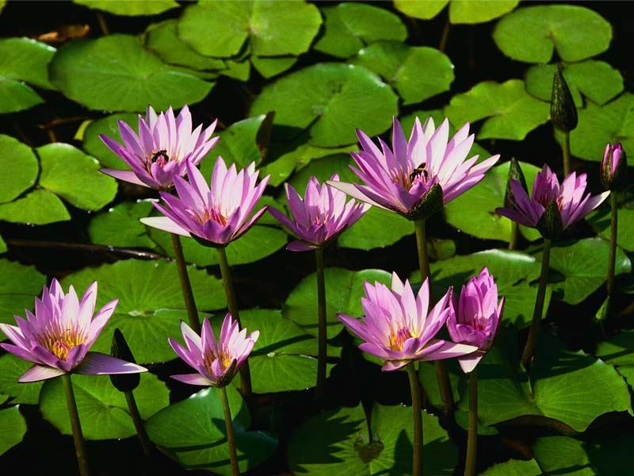
Questions Comments on Body Scan

Slide 15
Urge surfing and Smoking
Bowen & Marlatt, 2009
Psychology of Addictive Behaviors

Slide 16
Walking meditation with rope
All your anxiety about having to do this stupid exercise, let it go….
Pay attention to the sensations
When your mind wanders to thinking about this or that, let it go.. Pay attention to the feeling of the rope in your hand, the sound of walking, etc.

Slide 17
Balancing Thoughts: Mark
Nothing to do, nothing to achieve,
No one’s perfect I can understand that they made a mistake
This is something about myself I’d be willing to work on
Sometimes things don’t go my way and that’s frustrating but I can take it.
No one is 100 percent to blame, not me nor the other person.
Making mistakes doesn’t mean I’m stupid, broken, weak or bad.
I’ve done the same thing so I’m not going to judge them.
I’m not better than them and I don’t have to be.

Slide 18
Sitting Mindfully
Demonstration by Mark

Slide 19

Source for Cushions

Slide 20
Three minute breathing space
1. become aware of your: thoughts, feelings, sensations in the body
2. breathe in and out five times. Count to 5 on in breath and 5 on out breath. Relax on outbreath
3. Be aware of body as a whole. Posture and facial expression.
4. Add a balancing thought,

Slide 21
Mindfulness and Substance abuse incarcerated participants
Bowen, Witkiewitz, et. al., 2006, Journal of Addictive Behaviors
Ten day meditation retreat in the prison…

Slide 22
Tagging, Noting, or Thought labeling
Kurt explains how and walk them through an exercise.
As a thought comes across your mental screen, label it.
For religious people:

Slide 23
Mindfulness exercise: Sober
S- stop. When you’re in a risky or stressful situation, or even just at random times through out the day, remember to stop, slow down, check in with what’s happening. Step out of automatic pilot.
O-Observe. Observe the sensations in your body. Pay attention to the sounds, tastes, sights, your breath, ect. Notice if your thinking. Tag it thinking and let it go. No need to get into the drama.
B- Breathe. Breathe into your belly, breathe out. Relax with the out breath. Take several breaths, notice any contracted areas in the body. Breathe into them, relax and experience them as directly as you can.
E-Expand. Pay attention to your whole body. Allow some space to exist between you and whatever negative emotions or desires are arising. Notice any desire to escape what your feeling or the desire to get more of an experience.
R-Respond. When you feel you’re no longer in the grip of the feeling, mood, make a decision that is best for you in the long term, not just immediate gratification. Repeat the above steps as many times as needed until you feel able to respond.

Slide 24

Intermission

Slide 25
Example of working mindfully with urges and cravings
Four stages
Hand out the instruments, explain it
Hand out chocolate
Go though the urge exercise
Results will be …..

Slide 26
Case Presentation: Kurt

Slide 27
Case Presentation: Mark
Working mindfully with urge to drink…
4.17 Home from work after a long day. Earlier in the day I had a session with my therapist, and as we reviewed some counter transference issues I was having with some of my clients we came to a turning point where suddenly I was before the mirror trembling with a very young childhood terror I had of my mother. It hit me hard and I could feel the fear in my body, I found myself weeping as I drove to work and really used mindfulness to ground myself. After work, I just wanted to go home and have a drink and was looking for ‘the escape’, as I was still feeling raw to the bone.
MP: I did some breathing as I was driving home, reminding myself that I always pay a price for drinking during the week and I have so many deadlines at school.
MP: Went for a walk and watched my breathing and listened to the sounds of the evening.
MP: Sat for 15 minutes, just watched the breathing, I was so hungry, it was hard to focus.
Took a bath and decided to read and get an early night.
4.18 Taking a break from studying, I find myself wanting to be able to have a drink when M. gets here. He just called and said he was coming over earlier. I notice how I just want a quick way to relax, but know that I am not able to tolerate alcohol too well. I am feeling particularly tense about seeing Mark as lately he has gotten on my nerves and I easily get irritated with him. I also feel defensive because he easily de-rails me with my studies. I love that he is so interesting and intelligent but resent that he has a lifestyle where the deadlines are self imposed and rarely come from the outside, whereas mine, are drop dead dates for final projects.
MP: Played the piano in C major and E, holding the edge by letting the notes play themselves….then moved into Farruca cords E to A minor then to D minor and back. Couldn’t find my way out but eventually resolved in A. Working with the edges of the emotions it brought up in me, as I have traveled this landscape so many times and it is a progression I associate with having to endure things in my life, Endurance to acquire some kind of super human strength. In flamenco it is associated with facing the bull (powerful instinctive nature) and the farruca is the dance and ritual that precedes the kill. In this session there is no resolution and in fact I think it is trick to find one. Just like the breath, there is no beginning or end just the continuous field.
I feel sad today, good Friday.
MP: Stop for the PAUSE and a moment of focus on the breath and asking the struggle to come in for a talk. Not so much with words but with my being as it just let go of hanging on to itself. I’m exhausted with carrying around this heavy armor which doesn’t serve me anymore.

Slide 28
4.21 A few days go by, spent time out at the ranch with M. I really struggle to not indulge in having a few drinks. I have tried to remind myself that I feel fuzzy the next day even after a couple of drinks but it was the night I spend with my sister and we had a great dinner, M. joined us and I had probably 2 glasses of white. Just decided to let go for the evening even though I had a long day to get through. No intervention but just asking myself to notice what was happening. I slept really well.
4.22 When I got home this evening I wanted to have a drink but instead, I mindfully built a fire in the fireplace as the house was a bit chilled from the few days I had been gone. Really helped me. I have been a bit worried about some blood test results that the doctor called me about. I will have an appt on Thursday morning to get results, but I just had the test on Friday and she called Monday morning….. I worked on mindful walking during the breaks in class….very helpful. Worrying is not going to help me. I haven’t seen a doctor for over 10 years so I am paranoid at what they might discover. I have been trying to occupy any extra time with just breathing and staying with my awareness.
4.23 Craving a drink in class….. my cravings went up with each MP, except the last time after which I felt significantly less urge to have a drink. I did go home and have a drink with M, it was not all that satisfying.
4.24 This is the end of my week at practicum and I really wanted to relax, have a drink, build a fire, and chill….maybe watch a movie.
MP- I went for a walk when I got home and followed my breathing as best I could. Enjoying the sensory experience of being in the sun and the cool breeze.
When I got home and started feeling like I should work on something tonight, since Mark’s not here to de- rail me, I started sinking into wanting to have a drink. It is too hot to start a fire ( another MP technique). I warmed up the soup and tried to eat in a mindful way.
MP- Eating soup
This really brought down the desire. Now it is too late to really chill and have a drink. Will probably take a hot bath and maybe do my own reading.

Slide 29
Self Care
If you’re going to assist your clients to work on their issues mindfully you must practice yourself.
How does Kurt take care of himself. Don’t be honest..
  Hike and meditate and debrief…
How does Mark…sitting meditation…

Slide 30
Support for Everyday Mindfulness
Slow down
Talk less
When you can, do just one thing at a time. Reduce multitasking
Focus on your breath during daily activities
Relax into a feeling of calm presence with the other people
Use routine events-such as the phone ringing, going to the bathroom, or drinking water-as “temple bells” to return you to a sense of centeredness

Slide 31
Questions

